Slide 1
STUDENT JOBS
Group no-6
Group Members:
Nuzhut Tabassum (19-39967-1)
Tajkia Faruk (19-40009-1)
Atiqulla Habib (19-40022-1)
Shariar Sijan Alvi (19-40027-1)

Slide 2
Table of contents
Idea Generation
Use Case Diagram
Mock Design
Activity Diagram
Jira
Class Diagram
Git
Schedule
Estimation

Slide 3



Idea generation
Student's dependency
Financial support
Acquiring knowledge
Gaining experience

Slide 4
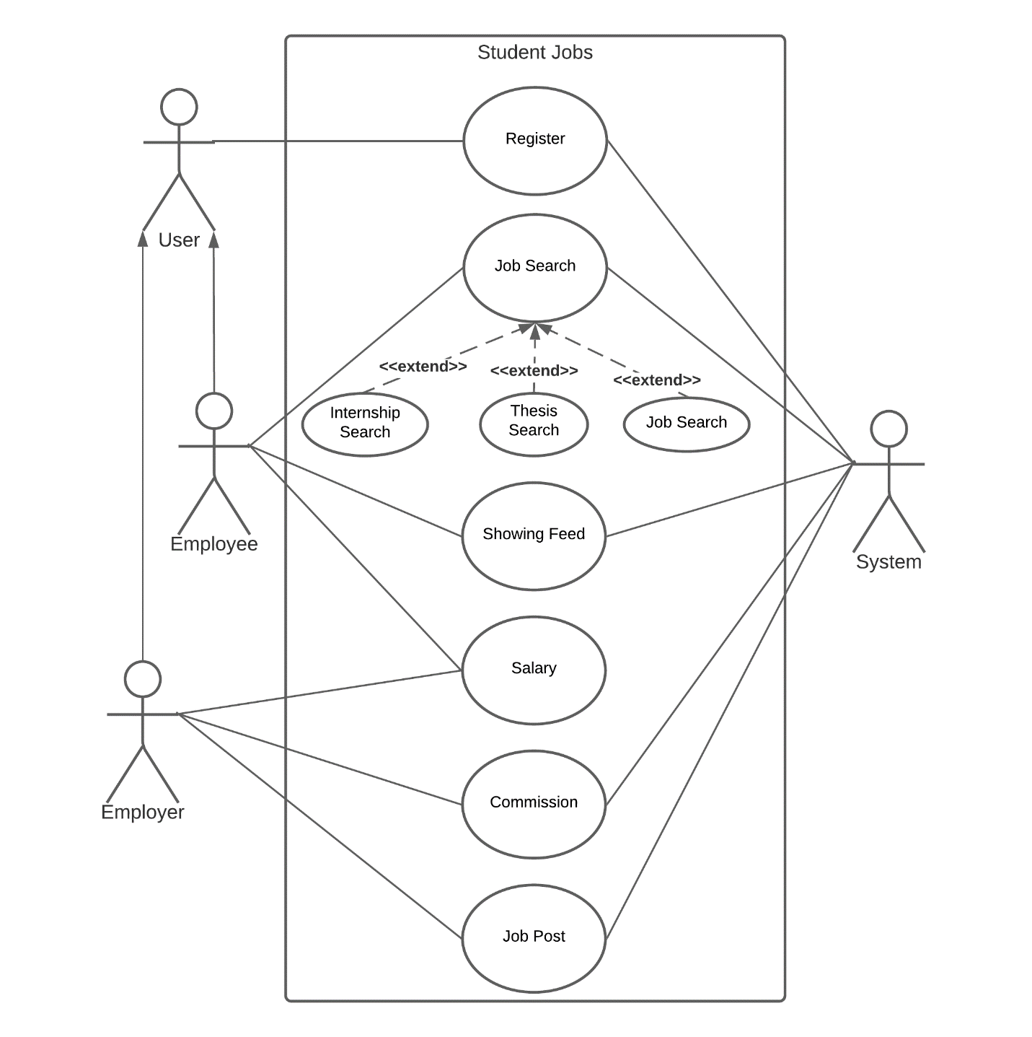
Uml use-case diagram
Contains use cases , actors and their relationships.
Specify desired behavior.
Enable to factor common behavior(Include).
Enable a optional system behavior(Extend).
Use case inherits the behavior and meaning of the parent use case(Generalization).
Serve as basis for testing.
Provide a way for developers, domain experts and end-users to Communicate.

Slide 5

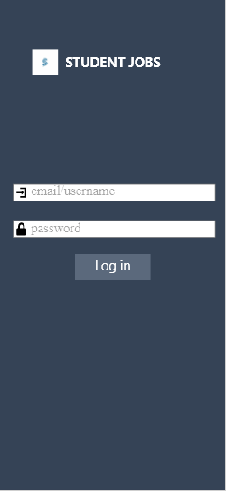

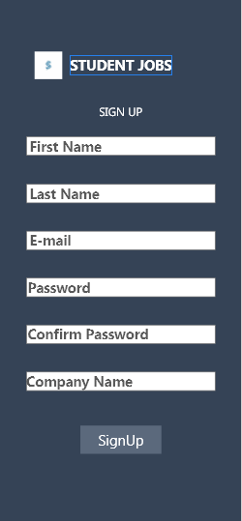
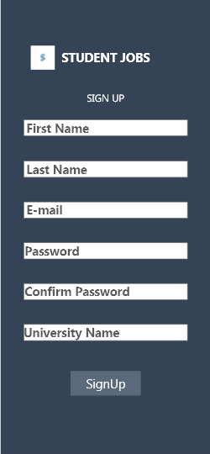
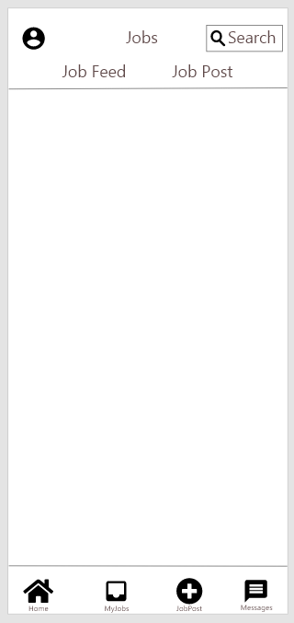
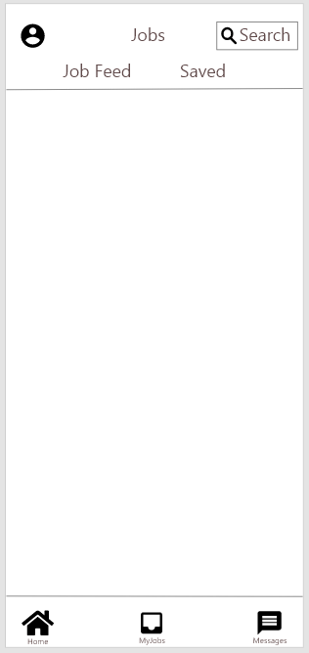
Mock design
Visual representation of user interface.
Used for product presentation.
Used by designers to acquire feedback
from users.
Showing off real world look like output’s
design.
A full size model of a system.

Slide 6
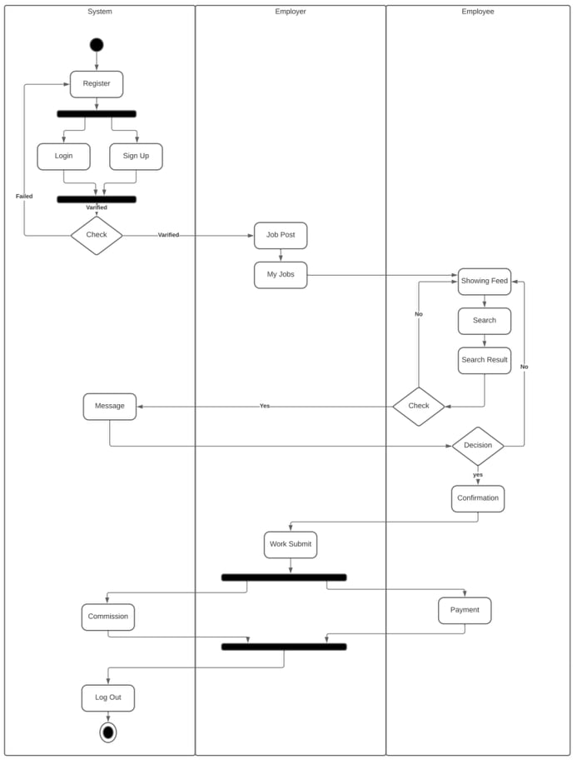
Activity diagram
Contains actions , activity nodes , flow and object values.
Visually presents the flow of control of all actions.
Describe the steps of a use case diagram.
Sequential and concurrent models.

Slide 7
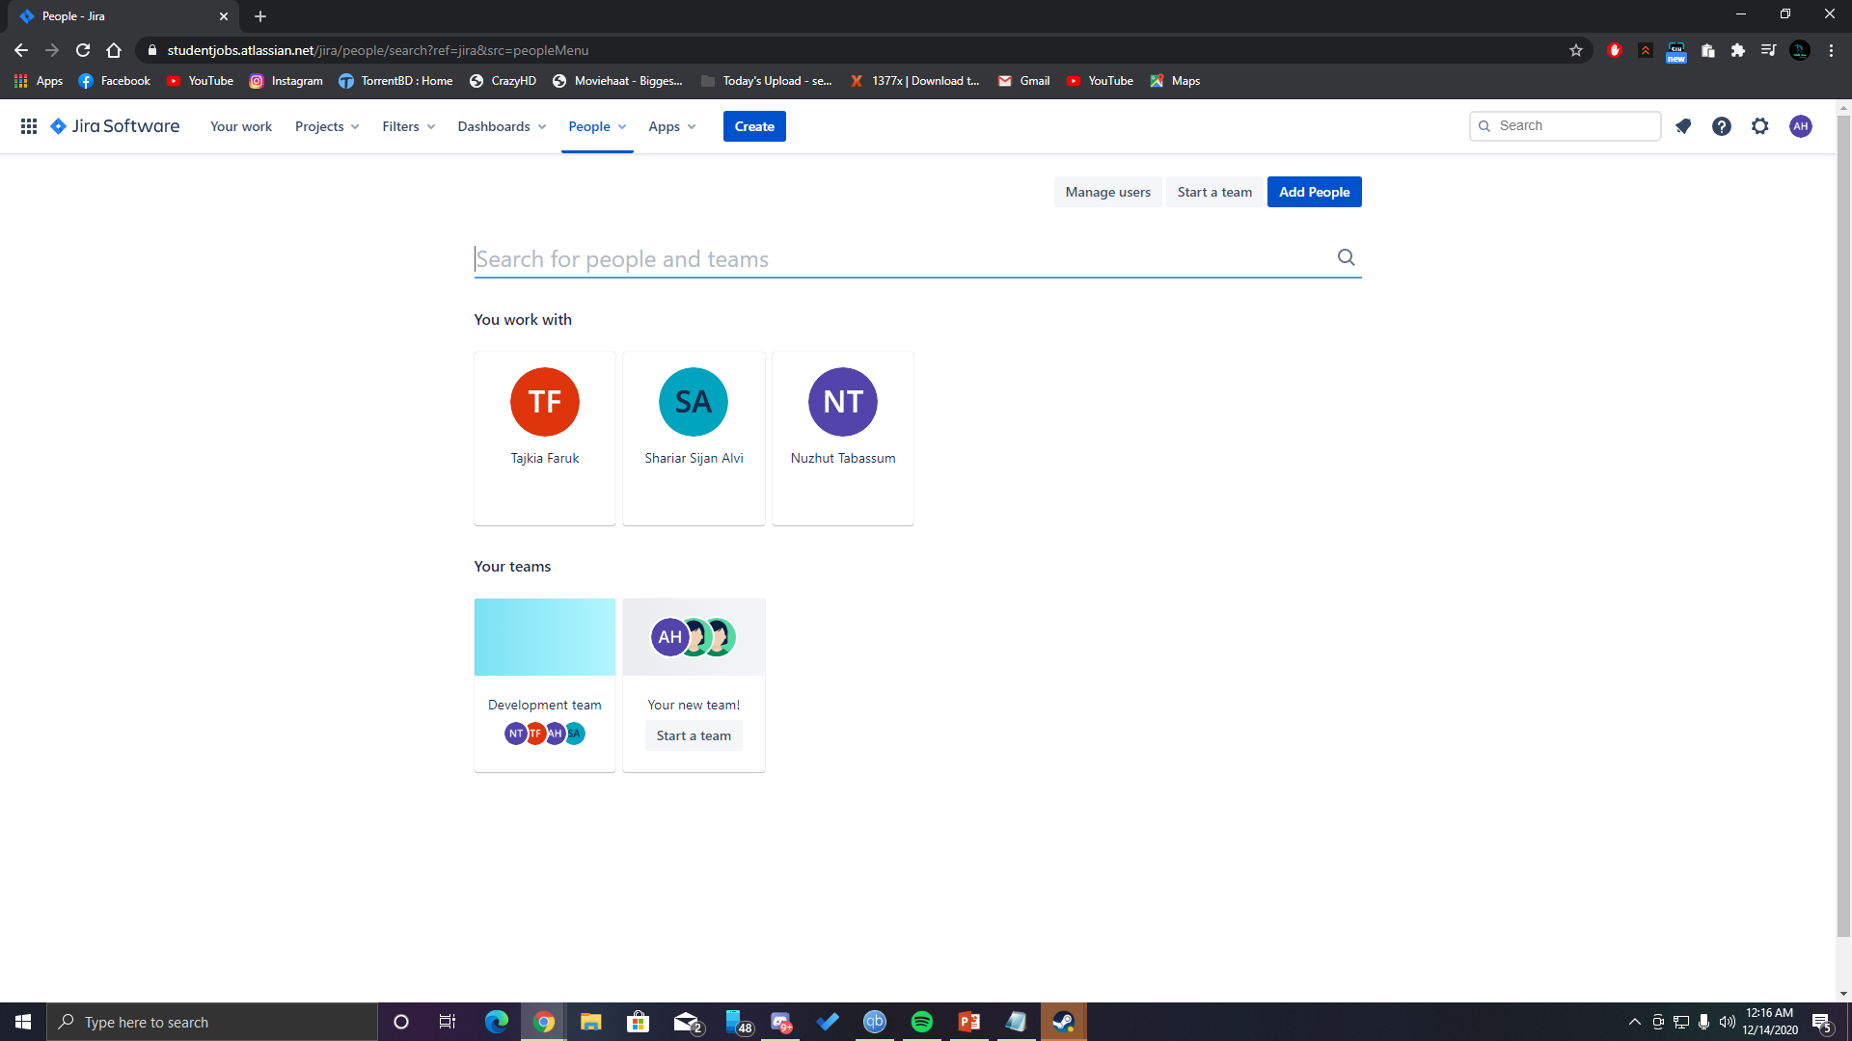
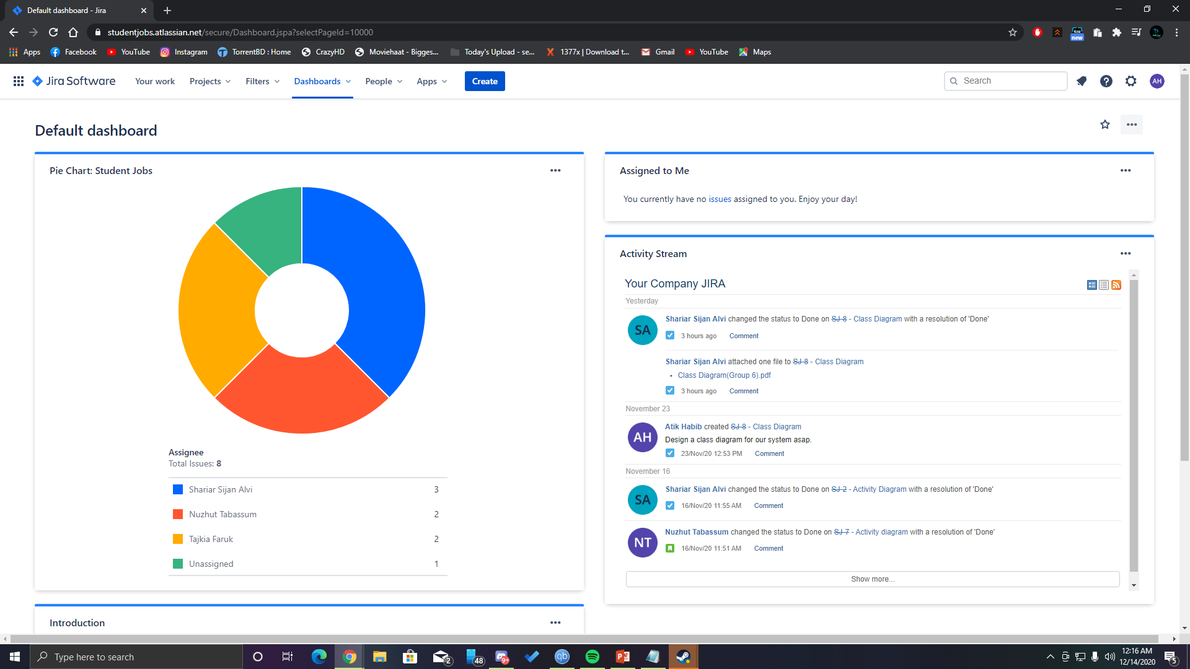
jira
Designed to help teams of all types manage work.
Designed as a bug and issue tracker.
Powerful work management tool for use cases,requirements and test case .
Used for software team to plan,trackand release great software.

Slide 8
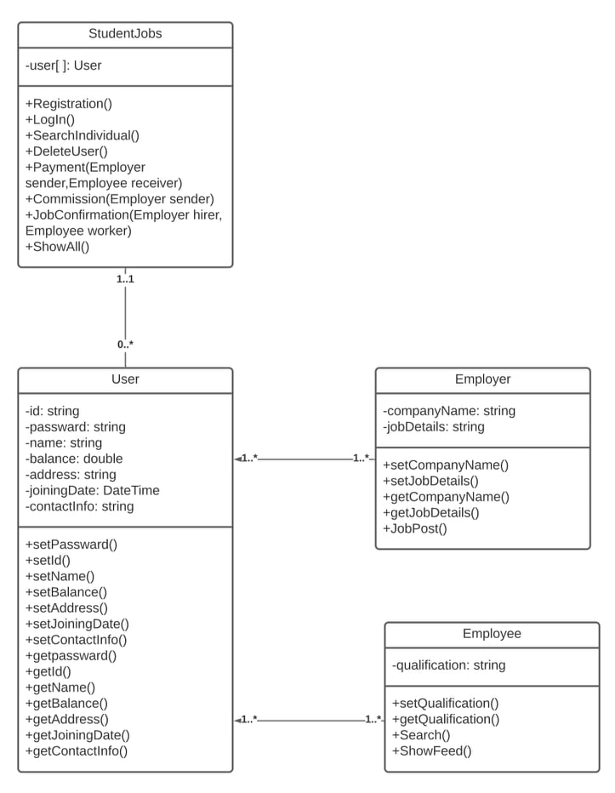
Class diagram
Includes attributes , operations , properties , associations and inheritance.
Objects express the facts.
Used for general conceptual modeling .
Used for data modeling.
Building block of object oriented modeling.

Slide 9

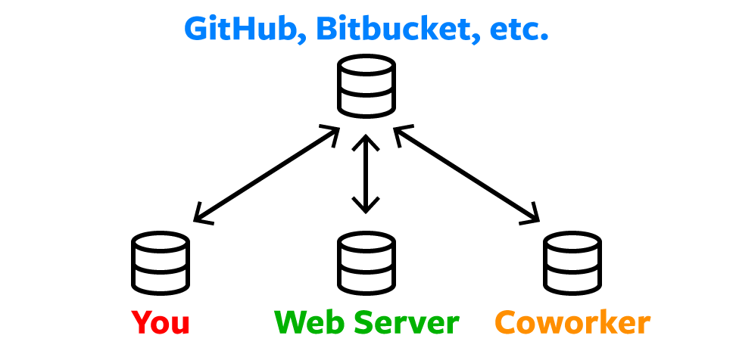
Git
Commonly used version control system.
Track the changes what make to flies.
Makes collaboration easier.
Allowing changes by multiple people to all be merged into one source.

Slide 10
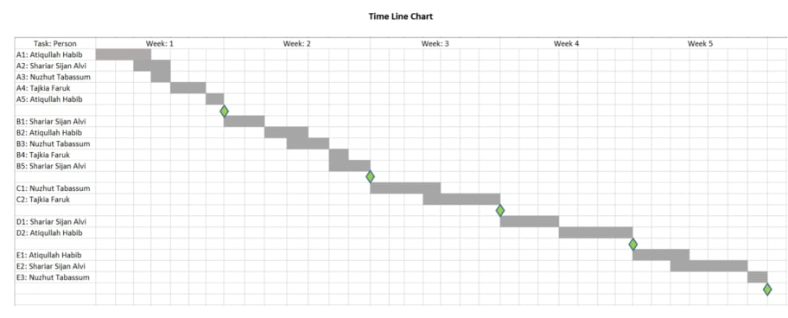
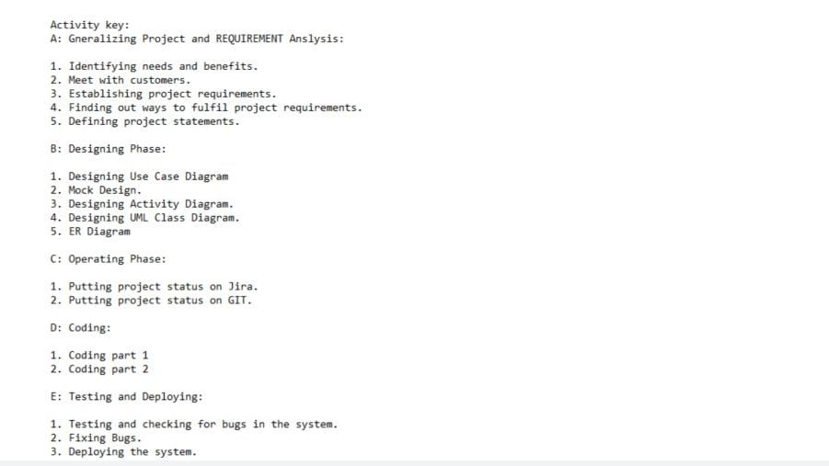
Schedule
Compartmentalization
Interdependency
Effort validation
Defined responsibilities
Defined outcomes
Defined milestones

Slide 11
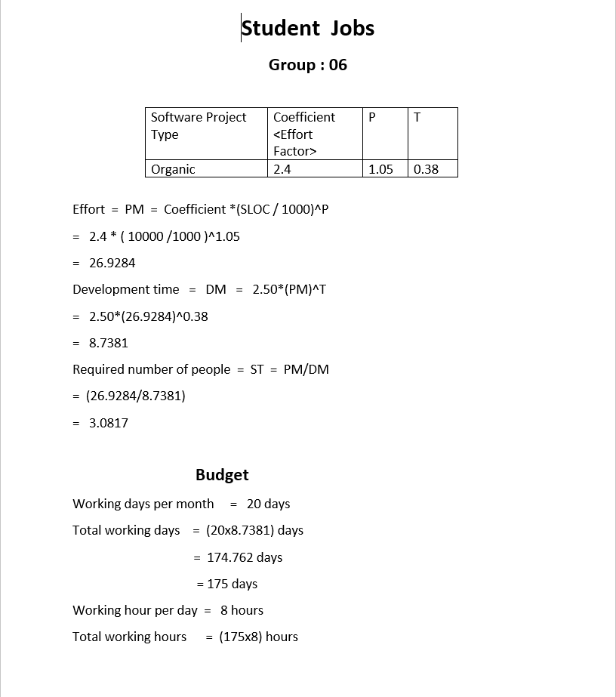
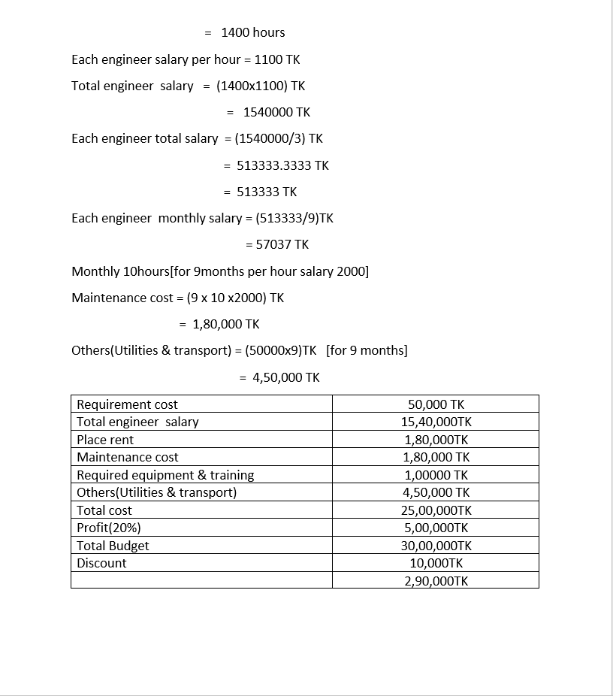
Estimation
Problem decomposing
Using historical metrics
Use COCOMO model to estimate expected cost

Slide 12
THANK YOu

